Slide 1
RENO NEVADA APARTMENT PORTFOLIO
$71,505,000
695 East Patriot Boulevard & 1350 Grand Summit Drive
722 Units | Multi-Family
Reno, NV
$99,037/Unit | 96% Occupied

Slide 2
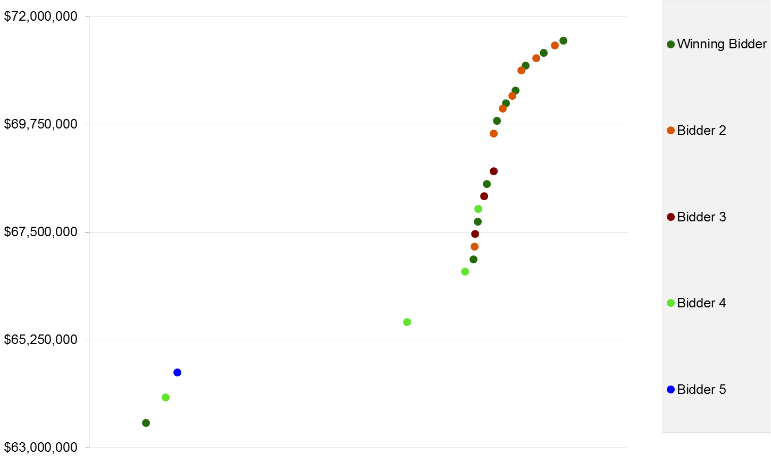
RENO NEVADA APARTMENT PORTFOLIO | Reno, NV
$71,505,000
722 Units | Multi-Family
Total Transaction Time: 100 Days
Close of Escrow: 9/3/2015
$99,037/Unit | 96% Occupied
Institution
Special Servicer
Stabilized suburban apartment portfolio
Top bidders from Southern California & Pacific Northwest
Price jumped 5% in last 30 minutes of auction
Tech job growth in market, including Amazon & Tesla
Institution
San Diego, CA | $2B+ Portfolio
Mission Capital
4,789 Web Hits
TOTAL PURCHASE PRICE: $71,505,000
169 Interested Buyers
20 Indicative Bids
SELLER’S RESERVE: $64,000,000
6 Finalists
27 Bids
Placed in
4 Hours
July 23
11:00 AM
July 23
12:15 PM
July 23
1:30 PM

